Slide 1
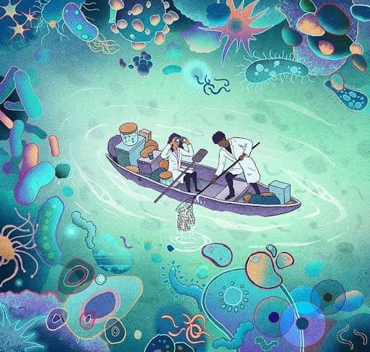
MICROBIOLOGICAL ASPECTS OF ANTIMICROBIAL THERAPY

Slide 2
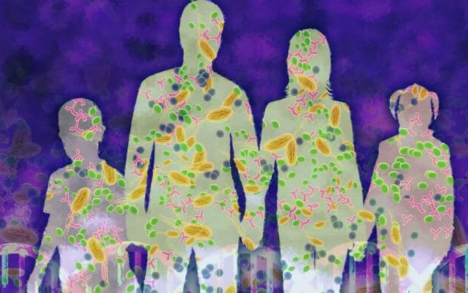
Relevance of the discipline
Infections remain leaders in the structure of human morbidity. The range of pathogens of these diseases is extremely diverse and variable over time.
The spread of resistance to antimicrobials among infectious agents has become the biggest problem in medical practice for last decade.

Slide 3
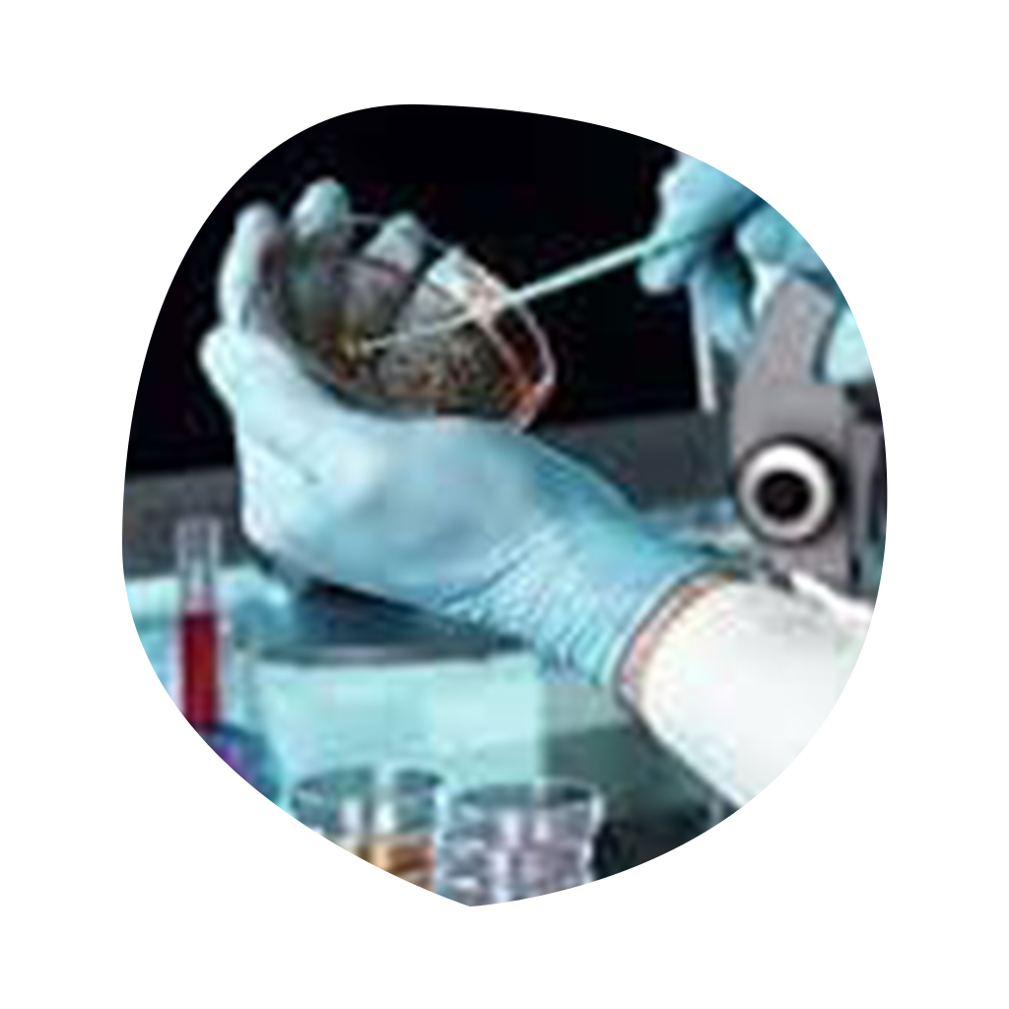
Therefore, special specific antimicrobial agents are needed for the treatment of diseases caused by microorganisms demonstrating different levels of organization. The modern range of antibacterial, antiviral, antifungal, antiprotozoal agents is extremely large including thousands of names, and diverse in specificity and effectiveness.

Slide 4



The aim of the discipline
Improving the educational level of students in the principles of rational antimicrobial therapy, methodology of formation of effective schemes for empirical antibiotic therapy, modern methods of topical antimicrobial exposure. Formation of the ability to flexibly manipulate existing methods and means of antimicrobial exposure in order to increase the effectiveness of treatment of diseases of microbial nature.

Slide 5
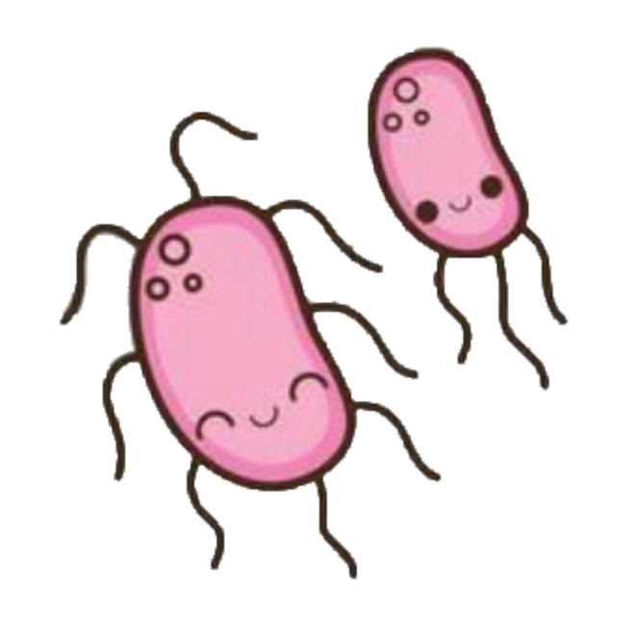

The main aim of the discipline
Get acquainted with the biological features of pathogens of different organization levels that may affect sensitivity to chemical influences.
Get acquainted with the modern list of antiviral, antibacterial, antifungal agents of different chemical structure and the mechanism of their action on pathogens.

Slide 6



To master the principles of rational antibiotic therapy, to get acquainted with modern schemes of combined empirical antibiotic therapy.
Acquire knowledge about the possibilities of local use of antibiotics and antiseptics and modern methods of local treatment in order to eliminate the etiological factor.

Slide 7

Main goals
To improve skills in antibiotic sensitivity detection and acquire ability for adequate assessment of the sensitivity results to antimicrobial drugs and predicting the effectiveness of infection case management.
To form ability to create highly effective schemes of combined antimicrobial therapy depending on cause of infection.

Slide 8
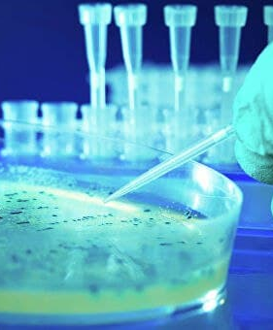

To deepen knowledge of the modern antivirals, antibacterials, antifungals, mechanisms of their action on pathogens, rationality of their use in different clinical cases.

Slide 9
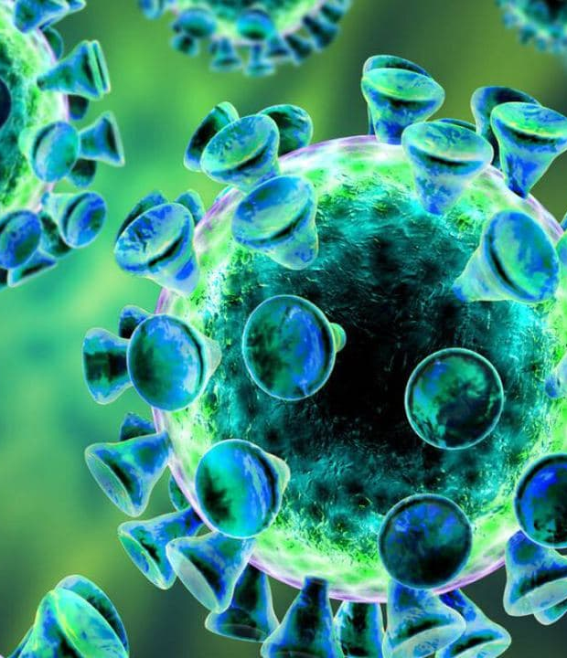
We are waiting for you at the Department of Microbiology

